Slide 1


Understanding Inclusion in the
Early Childhood Setting
Patricia Rosenlund, Executive Director
Easterseals Rio Grande Valley
Notes:
Served in the HOPES program so she has home visits with Parents as Teachers as the evidence-based program model
Impact:

Slide 2


Why is it important to provide Inclusive Opportunities for Children?
In Life…
At one point in our lives — one way or another — disability will touch every single American.
Redefining disabilities…
From… To…
Visible, physical conditions Include social, invisible emotional, & educational challenges
A limitation Being a part of normal, everyday life
A word that labels people A word that defines a barrier, not a person
Notes:
Why Easterseals got involved in home visiting– disabilities include social, emotional and educational challenges. Home Visiting programs address these conditions– in the home, meeting parents where they are.
Individualizes,

Slide 3


What do our partners say about Inclusion ?
ADA and IDEA:
Programs that receive state or federal funding can not turn away children with disabilities
Programs that do not accommodate children with disabilities are at risk of losing program funding
Legal action can be taken against entities that do not comply with reasonable accommodations and modifications for children
IDEA ensures services to children with disabilities and governs how states and public agencies provide early intervention & special education services– PART B and PART C

Slide 4

What do our childcare partners say about Inclusion ?
Childcare Minimum Standards:
Children with special needs: 746.1205 Supervise Children at all times to determine how closely caregivers need to supervise children based on individual differences and abilities
Training: 746.1309 24 hours of training clock hours for childcare providers
Each Provider must show annual clock hours in the care of children with special needs
Cultural diversity of Children & Families
Center Directors Training : 746.1311 – Center Directors must be trained 30 hours annual with at least 6 hours in category including serving children with special Needs
Determining child/ caregiver ration? : 746.1507 – you may use developmental and emotional age, rather than chronical age
746.3815 – medical assistance –Providers must provide specialized medical as required by a medical provider for children who require assistance or special medical care
Notes:
Served in the HOPES program so she has home visits with Parents as Teachers as the evidence-based program model
Impact:

Slide 5

What do our partners say about Inclusion ?
WORKFORCE:
Childcare centers must not turn away children with special needs because of their disability
Your funding and participation in Texas Workforce Childcare Services are at risk if you are intentionally turning away children with disabilities
Notes:
Served in the HOPES program so she has home visits with Parents as Teachers as the evidence-based program model
Impact:

Slide 6

What do our partners say about Inclusion ?
CACFP/Department of Agriculture:
Childcare centers must not turn away children with special needs because of their disability
Civil Rights Training must be completed annually by all staff
It is a child's civil right to be offered food and nutrition services regardless of disability
Funding and participation in CACFP Services is at risk if intentionally turning away children with disabilities
Notes:
Served in the HOPES program so she has home visits with Parents as Teachers as the evidence-based program model
Impact:

Slide 7



Inclusion Is…
American Girl is starting off the new year with a message of ambition and inclusivity. Joss is the American Girl's first-ever doll who has a disability.
"She has congenital hearing loss. She was born deaf in her left ear and can hear a little bit in her right ear," American Girl president Jamie Cygielman told USA TODAY.
American Girl has offered dolls that can be fitted with hearing aids and dolls with crutches and wheelchairs, but Joss is the first character whose disability is part of her story.
Mainstream
Notes:
Served in the HOPES program so she has home visits with Parents as Teachers as the evidence-based program model
Impact:

Slide 8
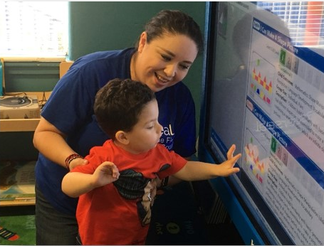

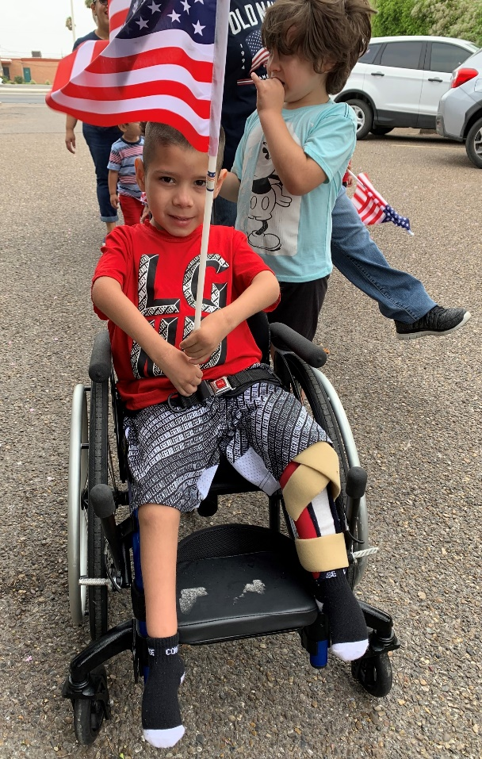
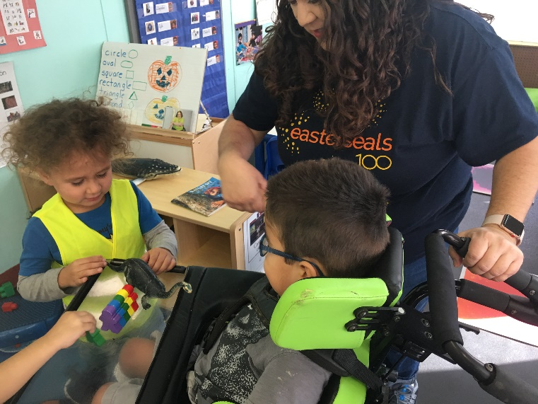
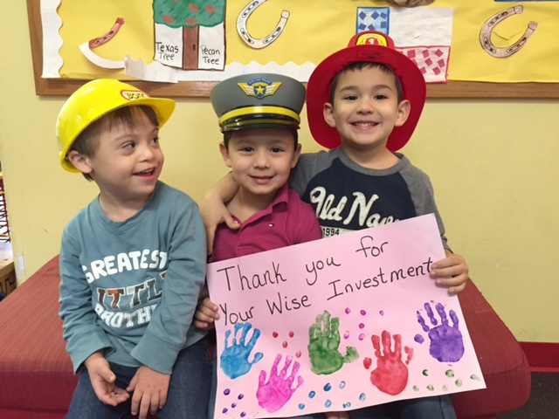
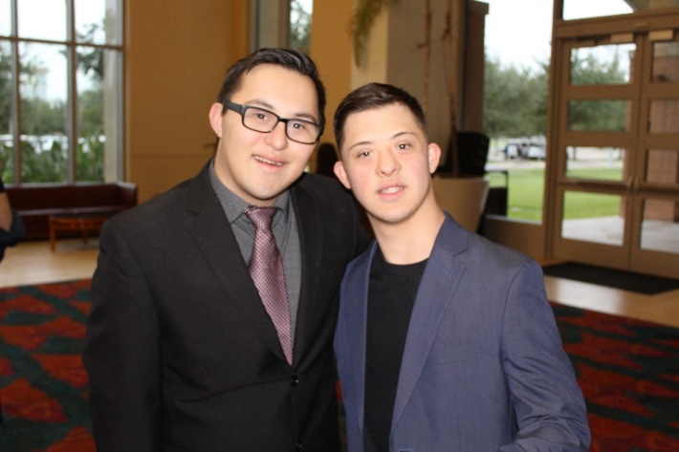
Inclusion Is …
A Different Way of Learning
Gainful Employment
Life Long Friendships
Notes:
Served in the HOPES program so she has home visits with Parents as Teachers as the evidence-based program model
Impact:

Slide 9
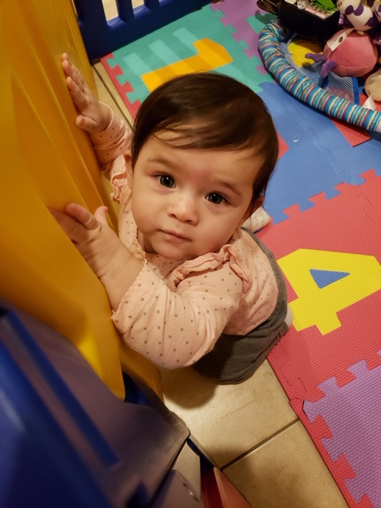
The importance of inclusion….
    It’s about opportunity
    Good practice and policy and law
    Impact
    Partnerships
    Community engagement
Notes:
Served in the HOPES program so she has home visits with Parents as Teachers as the evidence-based program model
Impact:

Slide 10

Notes:
How our agency provides a system of services to meet the needs of families and works with our partners/NFP

Slide 11

Working with families and partners through the
Coaching Model
Notes:
How our agency provides a system of services to meet the needs of families and works with our partners/NFP

Slide 12
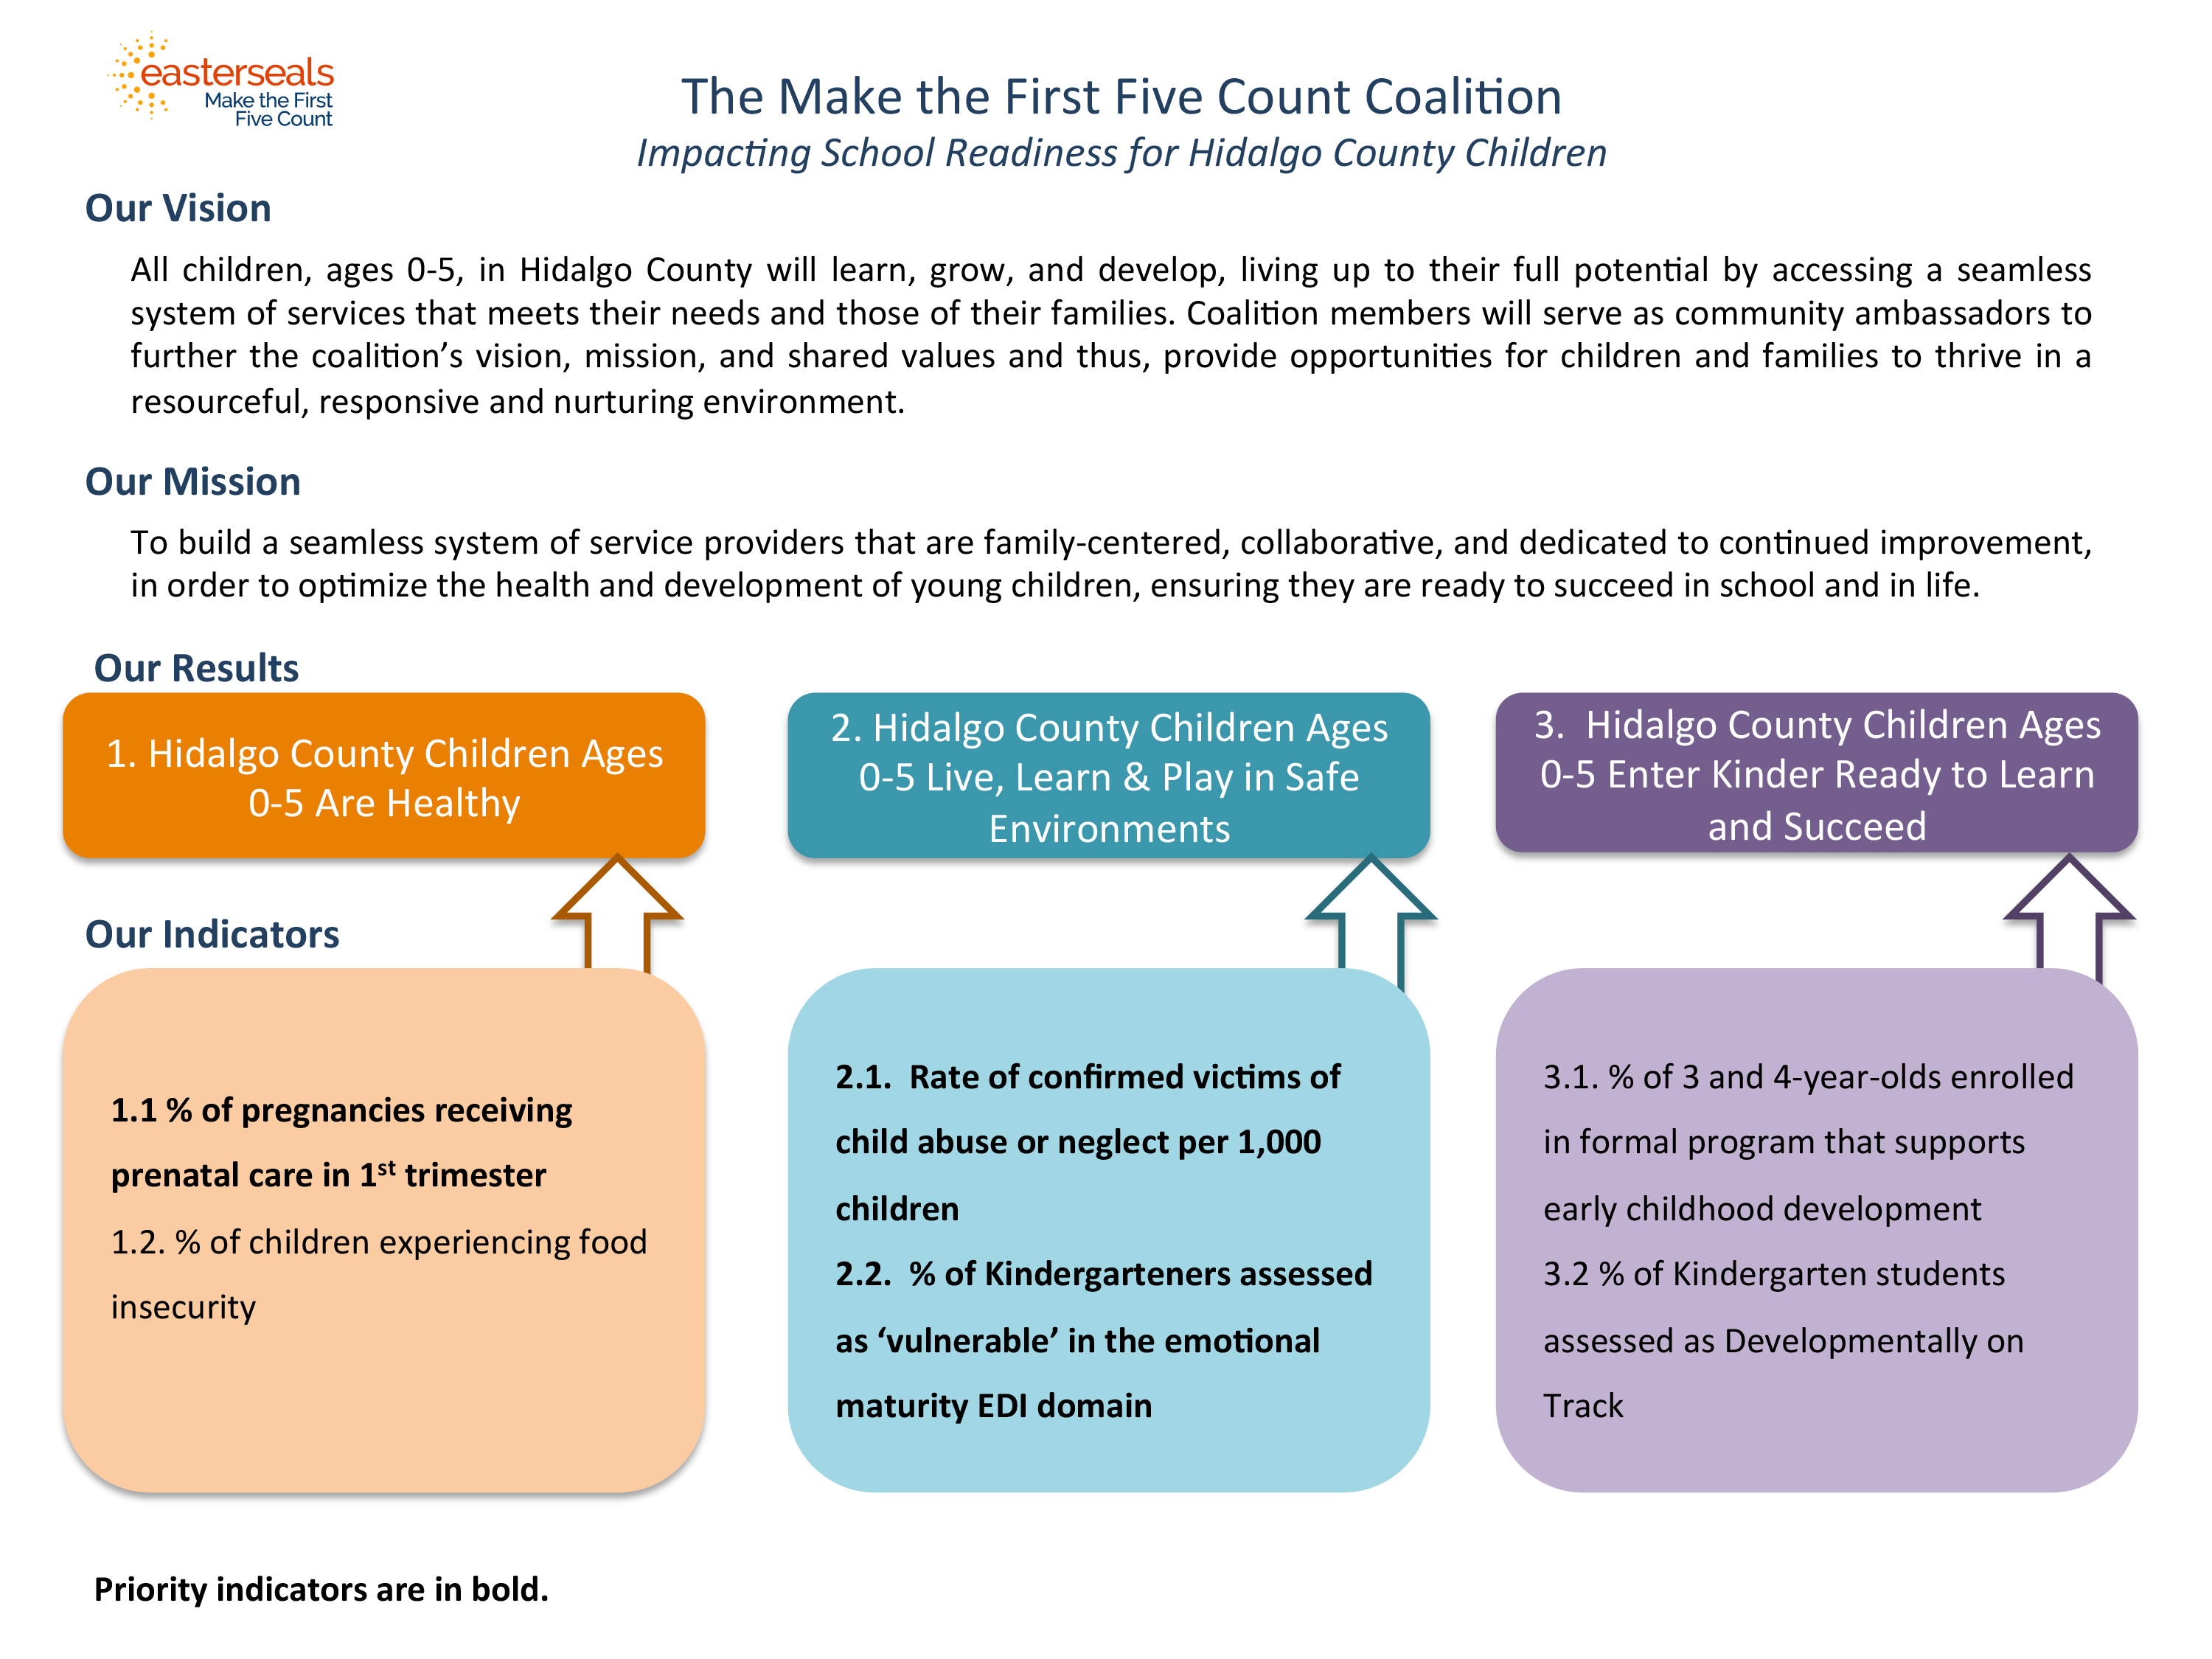
Notes:
Coalition priority Results:

Slide 13
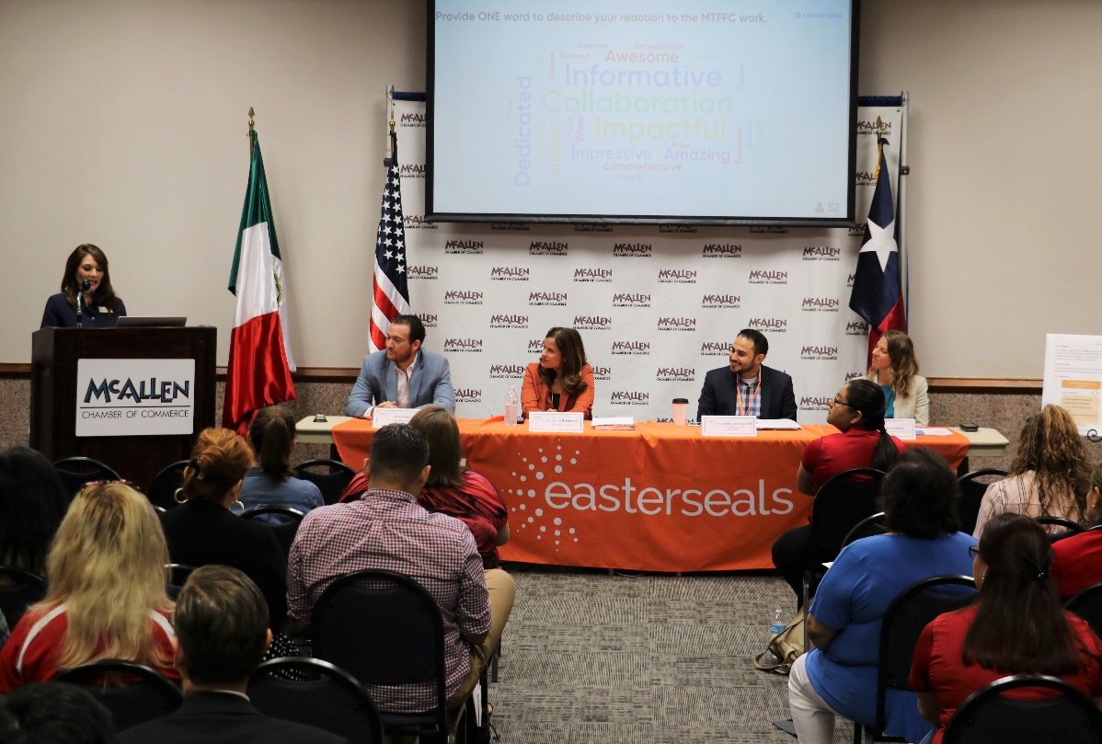
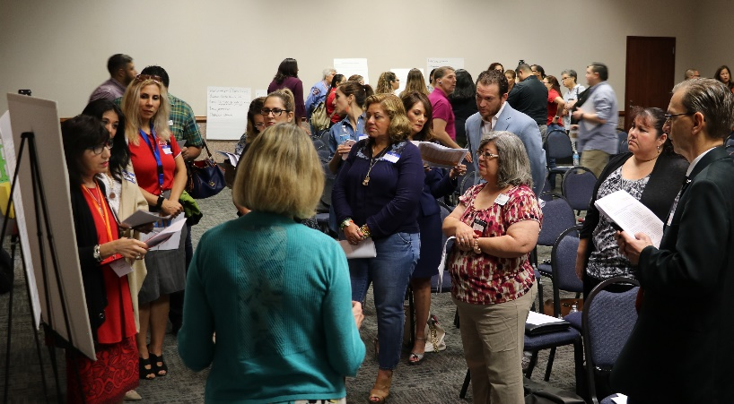
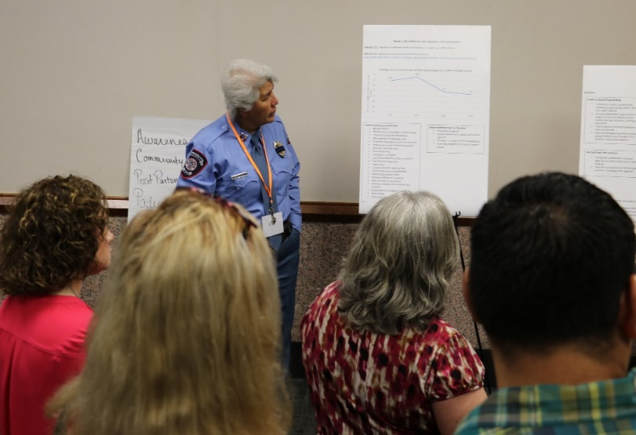
Make the First Five Count Coalition Community Forum
Notes:
Coalition Work: Make the First Five Count Coalition: Panel Members: Veronica Gonzales, Rep Terry Canales, Judge Betancourt, Dr. Lopez, Sarah Abrahams

Slide 14
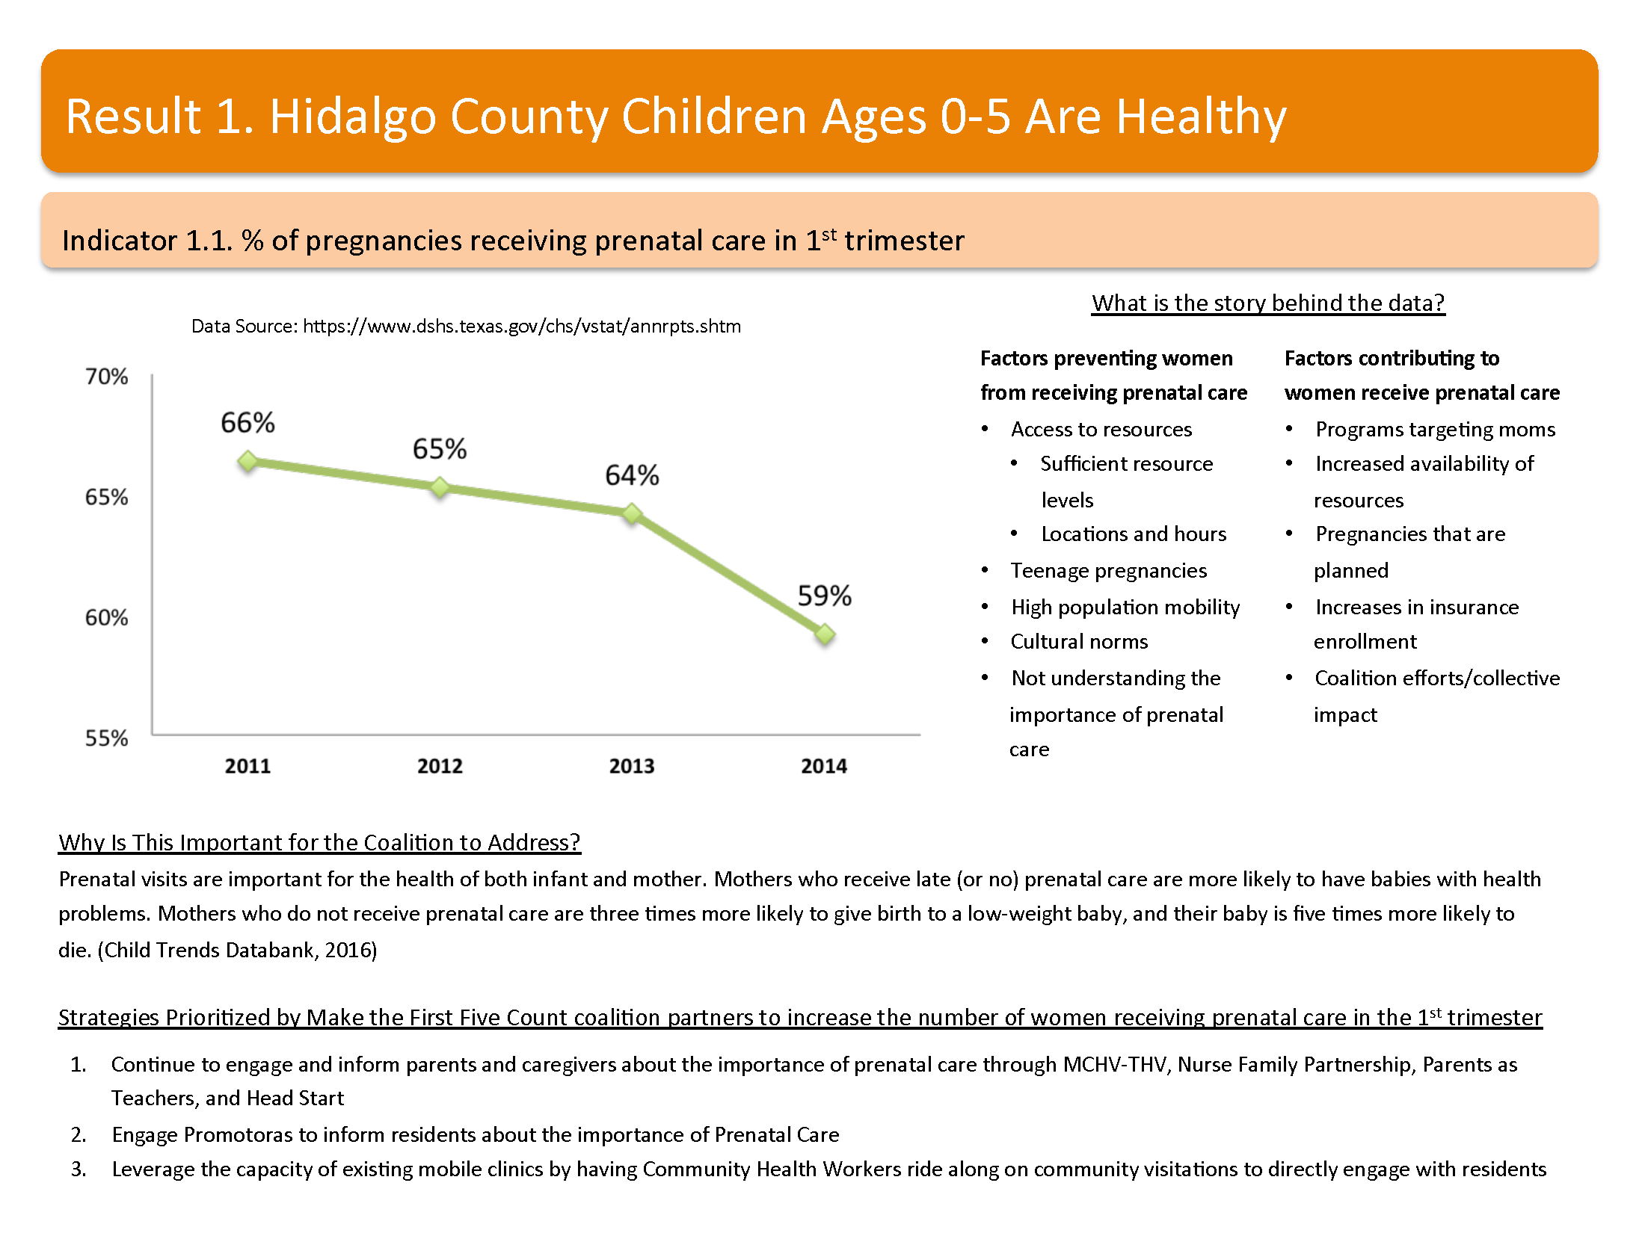

Slide 15
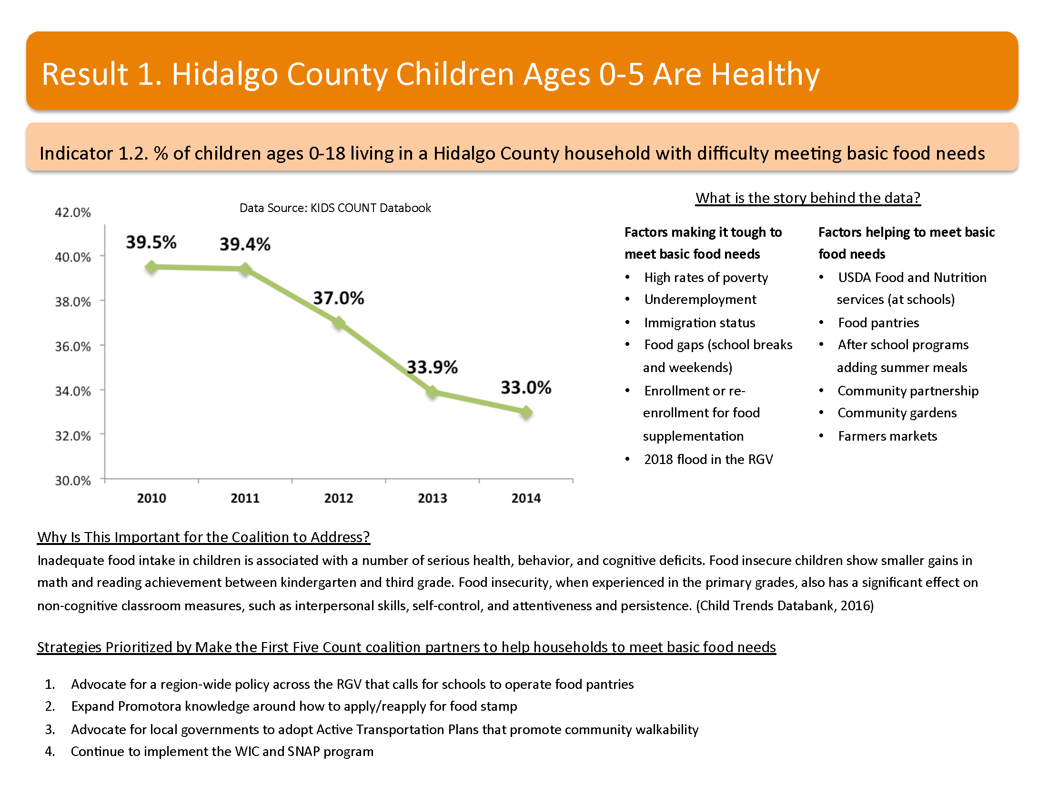

Slide 16
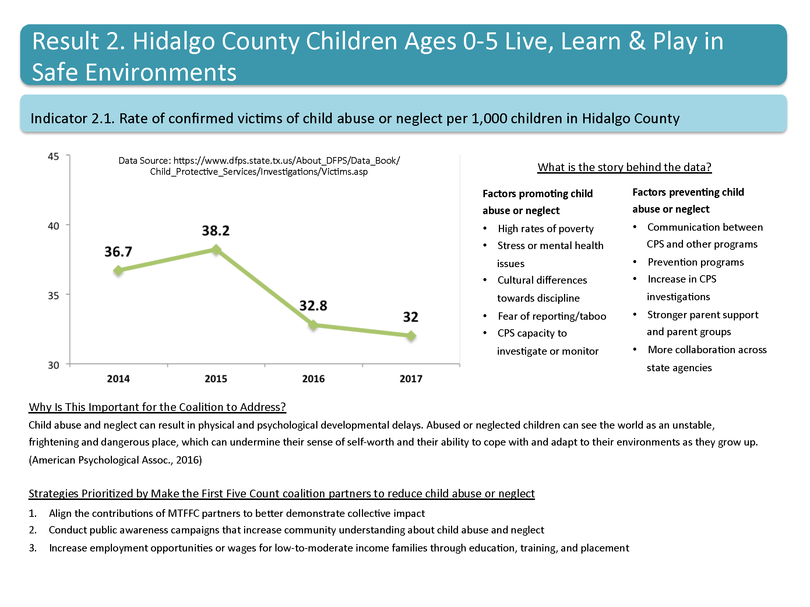
Notes:
Social Impact:

Slide 17
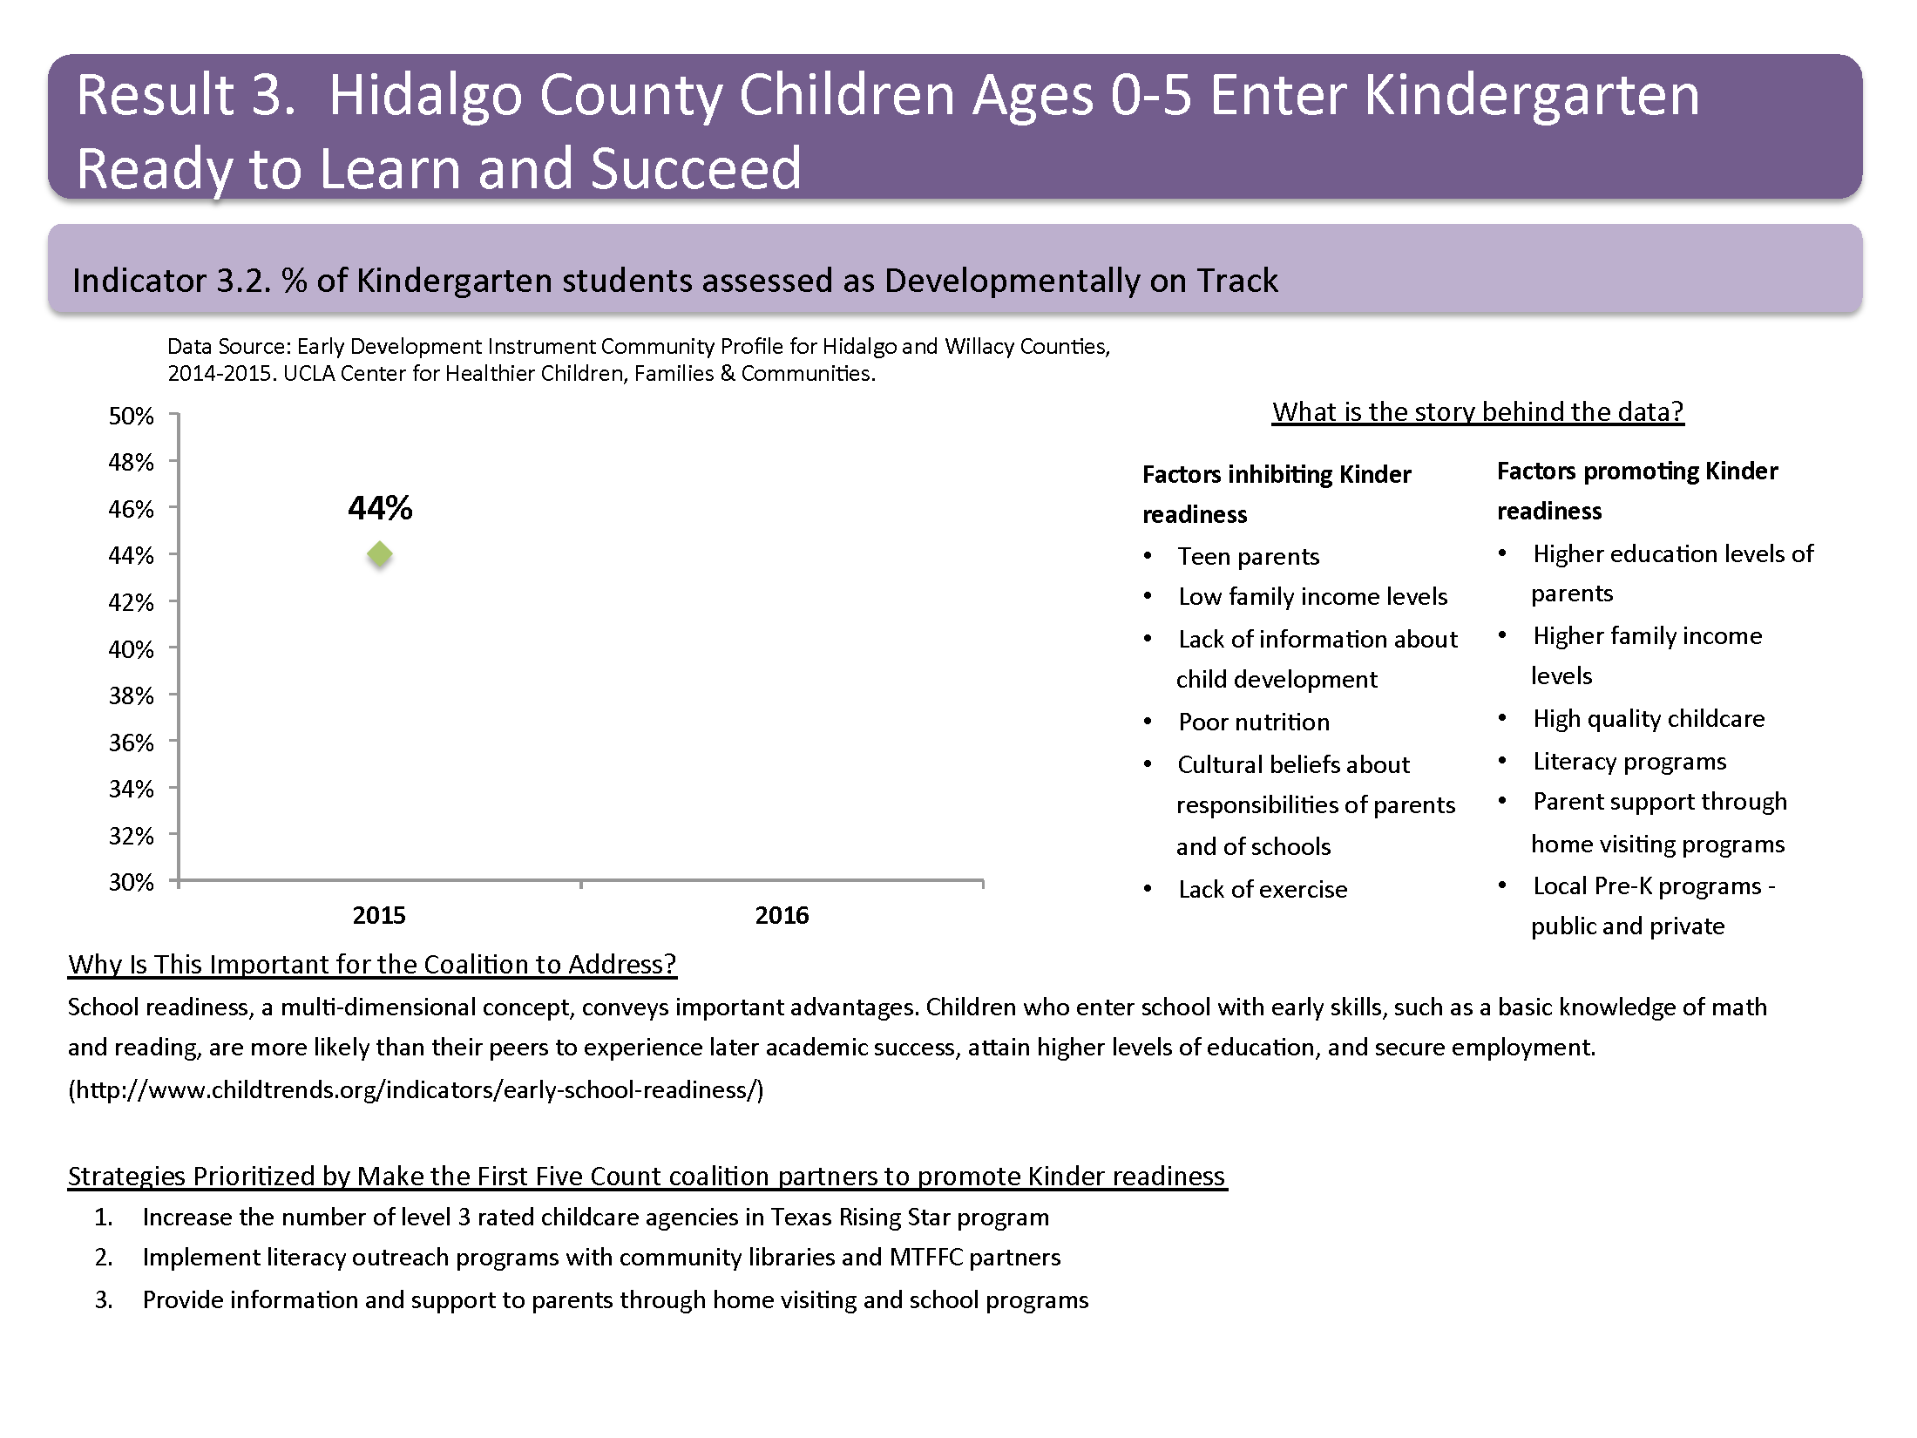

Slide 18
Notes:
Impact on School Readiness: HOPES PAT program: 152 children, over one year, 14% Very Delayed to 6% 31% delayed to 25% Average scores moved from 51% to 57% Advanced scores moved from 3% to 11%

Slide 19
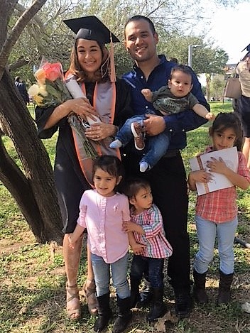
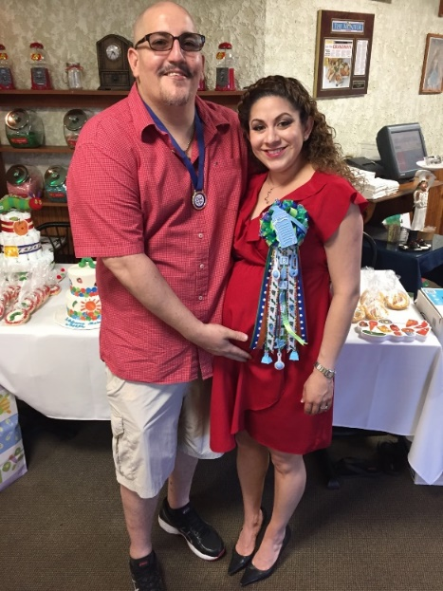

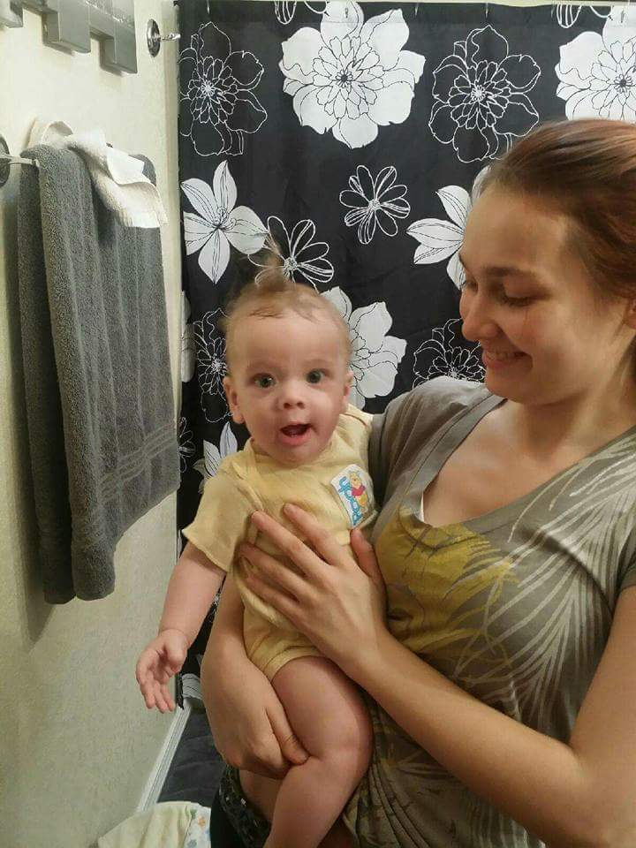
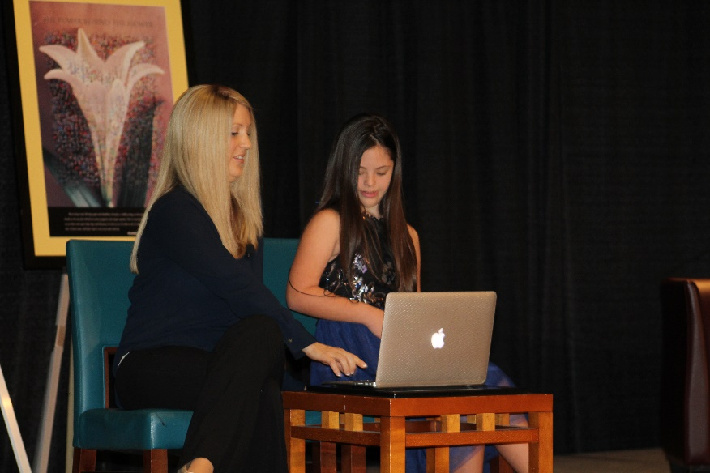
Family Stories of Impact…. Most important Partner
Parents are the Champions of Inclusion
Notes:
Stories of Impact: Addressing and supporting families with high risk factors: Davis family, young mothers succeeding, School success with child and parent, Dago with ECI

Slide 20
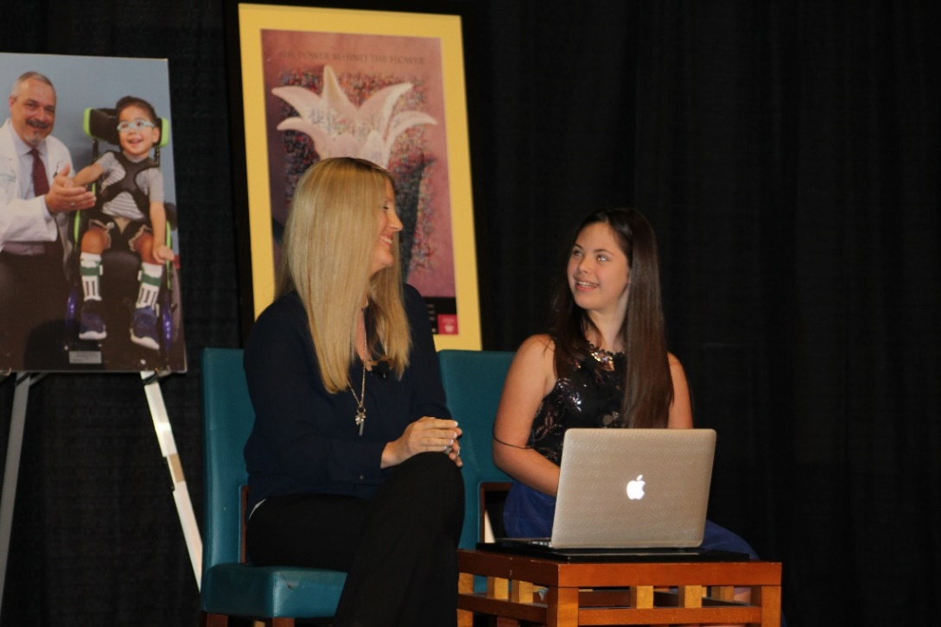
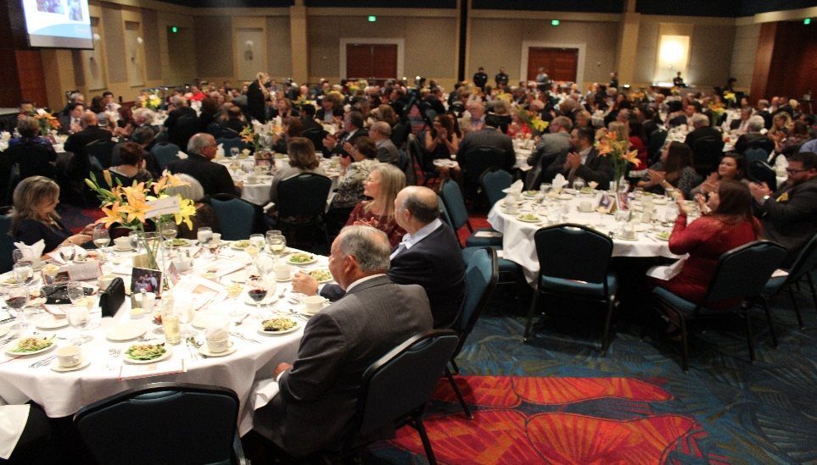
Addison’s Inclusion Message…..
Hi My name is Addison Bortnick.
I am a FIERCE self-ADVOCATE
I am a 6th grader at Cathy middle school.
(This is my mom Becca)
TOGETHER we are paving the way for EQUILITY,
NOT only people with Down syndrome,
but people of ALL Abilities.
People are NOT their DISABILITIES
they are People FIRST.
I UNDERSTAND many teachers, peers, and people in our community
JUST DON’T KNOW how much me and others with disabilities are capable of,
OR the value we bring because they are NOT given the OPPERTUNITY
because many individuals with disabilities are SEGREGATED in
“Special Education” Environments.
Notes:
Served in the HOPES program so she has home visits with Parents as Teachers as the evidence-based program model
Impact:

Slide 21
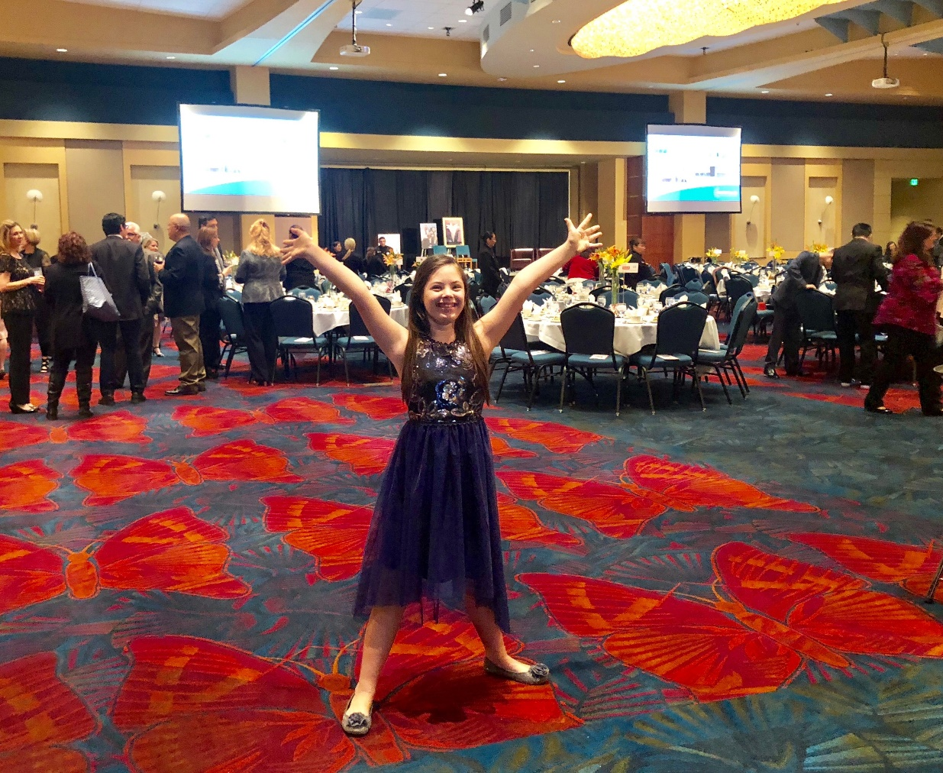
Addison’s Inclusion Message…..
This has GONE on for FAR too long.
I have Down syndrome but that
DOES NOT DEFINE who I am.
I am PROUD to be ME
I was NOT Born to be HELD DOWN
I was BORN TO SHINE
I believe in myself,
Do YOU believe in me?
Notes:
Served in the HOPES program so she has home visits with Parents as Teachers as the evidence-based program model
Impact:

Slide 22
How you support Inclusion:
  Inclusion is Person First------ use person-first language
  Ensure children or adults with disabilities/key populations, are involved and considered when planning
  Engage parents- they are the experts of their child
  Make inclusion part of the process check with partners– asking, can all individuals participate? Are we reaching individuals/representatives from all sectors of the community?
Notes:
Served in the HOPES program so she has home visits with Parents as Teachers as the evidence-based program model
Impact:

Slide 23
Just do it…
Children with disabilities should be supported in the same environments as their siblings, the neighborhood children and other children without disabilities
Inclusion is not defined as a location; it is active participation with supports
All programs/groups should engage in on-going self-assessment of their level of inclusion to increase inclusion opportunities
There is no “type” of child who cannot be successfully included, just more that we need to learn
Status quo is not acceptable: We must seek to do better for our children and families in our communities
Notes:
Served in the HOPES program so she has home visits with Parents as Teachers as the evidence-based program model
Impact:

Slide 24
Inclusion from a child’s perspective:
Patrick won a school district essay contest with his creative expression of inclusion
I nclude everyone
N ever, ever left out
C hoose to include
L eaving someone out is wrong
U nfair for others to be left out
S omething for everyone
I nvite everyone
O utrageously fun when …
No one is ever left out!
Notes:
Natural environment– least restrictive environment
where services are provided
Assess your center– are all kids included, all the time?
Note:
If a child is already in the program and is identified as eligible for early intervention– their supports should be provided in that setting. More on working with early intervention and therapy this afternoon.
Looking at the environment, activities, materials, cooperative learning, doing something different…. More on accommodations in the upcoming breakout sessions.

Slide 25


Slide 26

Thank you for partnering for quality early learning, prevention and intervention that give children the best start in life!
Pattie Rosenlund, Executive Director, Easterseals RGV

